Slide 1
Design Patterns in Practice
Rasmus Lystrøm
Associate Professor
ITU
rnie@itu.dk

Slide 2
Agenda
Gilded Rose Refactoring Kata
Design Patterns

Slide 3
Gilded Rose
Hard problem
If you don’t get it now, you will (probably/hopefully) understand later
”For each desired change, make the change easy (warning: this may be hard), then make the easy change”
Kent Beck, 2012
https://twitter.com/kentbeck/status/250733358307500032

Slide 4
Design Patterns
IoC Container
Adapter
Factory Method
Singleton
Façade
Chain of Responsibility
Strategy
Bridge
Saved for later:
Command (MVVM)
Observer (MVVM)
Proxy (Web API)
Probably not covered:
Decorator
Visitor
Composite

Slide 5
IoC Container
Tool to facilitate dependency injection.
Using a factory to either manually or automatically create types at runtime.
Various implementations:
Microsoft.Extensions.DependencyInjection
Ninject
Unity
AutoFac
StructureMap

Slide 6
IoC Container II
Lifetime:
Transient (every time)
Scoped (once per request)
Singleton (once)
Lifetime:
Transient
Scoped
Singleton

Slide 7
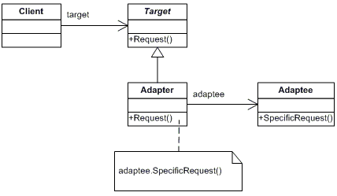
Adapter aka Wrapper
Unmodifiable implementation which does not match the interface you need.
Static or sealed class or class in another assembly.

Slide 8
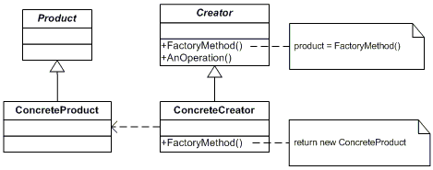
Factory Method
A method which can creates instances of a given type.

Slide 9
Singleton
Only ever one single instance of a given type.
Considered an anti-pattern by many, it:
is overused
introduces unnecessary restrictions in situations where a sole instance of a class is not actually required
introduces global state into an application

Slide 10

Singleton II
Use carefully
Implement using an interface
Use an IoC container

Slide 11
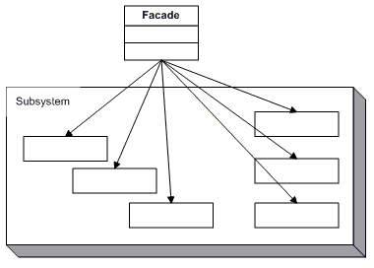
Façade
Simplify the use of a system
Provide a uniﬁed interfaces for a group of “dispersed” functionalities from a multitude of interfaces/classes

Slide 12
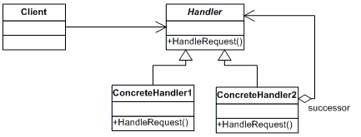
Chain of Responsibility
Avoid coupling the sender of a request to its receiver by giving more than one object a chance to handle the request. Chain the receiving objects and pass the request along the chain until an object handles it.

Slide 13
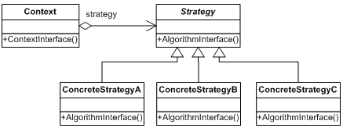
Strategy
Define a family of algorithms, encapsulate each one, and make them interchangeable. Strategy lets the algorithm vary independently from clients that use it.

Slide 14
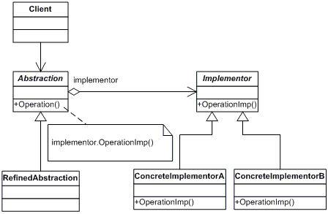
Bridge
Decouple an abstraction from its implementation so that the two can vary independently.

